Slide 1

FUNDAMENTALS OF ICT:
Part A: Components of Computer System

Slide 2





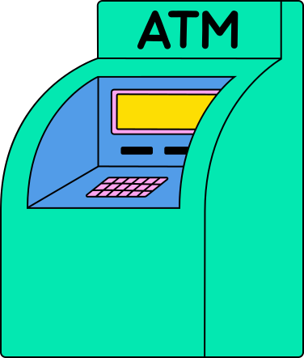

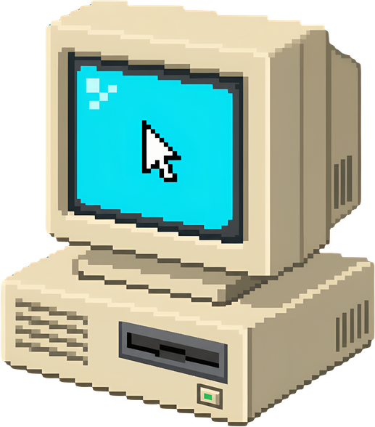
How many computers did you use today?
Smart TV
Cellphone
Laptop
ATM
Computer

Slide 3
If they are all computers, why do they look different?
Smart TV
Cellphone
Laptop
ATM
Computer

Slide 4



WHAT IS COMPUTER?
  Computer is an electronic device that processes data according to instructions provided by software programs. It takes input (data), processes it using a central processing unit (CPU), stores information, and produces output (results) to perform various tasks.
Process (CPU)
Display Output
Input (data)
Stores Information
Notes:
A simple analogy:
ICT is similar.
- Developers create software.
- Network engineers connect computers.
- Database administrators manage data.
- IT support fixes technical problems.
- Cybersecurity specialists protect information.
ICT is a combination of hardware, software, communication network, data, and people working together to help us create, process, store, and communicate information.

Slide 5
Why Were Computers Invented?
To automate complex calculations, reduce human error, and increase efficiency in processing data.

Slide 6
FUNDAMENTALS OF ICT
History of Computer: Basic Computing Periods
Earliest Computers originally calculations were computed by humans, whose job title was computers.
  These human computers were typically engaged in the calculation of a mathematical expression.
  The calculations of this period were specialized and expensive, requiring years of training in mathematics.
  The first use of the word "computer" was recorded in 1613, referring to a person who carried out calculations, or computations, and the word continued to be used in that sense until the middle of the 20th century.

Slide 7
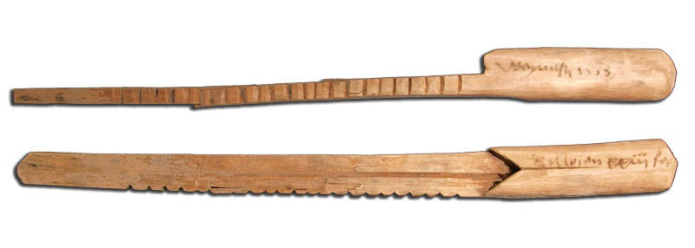
FUNDAMENTALS OF ICT
Tally sticks
A tally stick was an ancient memory aid device to record and document numbers, quantities, or even messages.
Notes:
PURPOSE:
the main purpose of a tally stick was to help people count and keep a physical record of quantities or transactions before modern writing, calculators, and digital systems existed.
A tally stick was an early information-storage and counting device. Instead of writing numbers on paper, people carved notches into wood or bone to record quantities, debts, payments, or other information

Slide 8
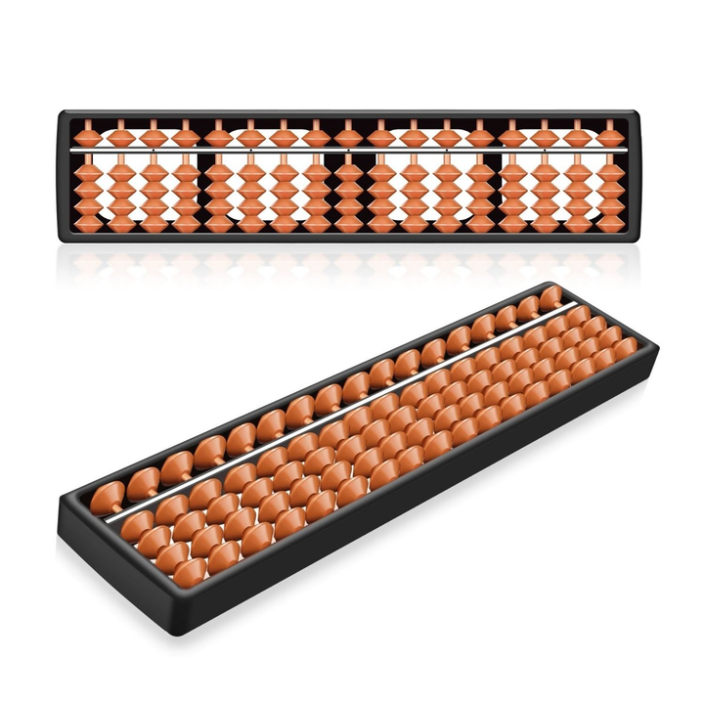
FUNDAMENTALS OF ICT
Abacus
An abacus is a mechanical device used to aid an individual in performing mathematical calculations.
  The abacus was invented in Babylonia in 2400 B.C.
  The abacus in the form we are most familiar with was first used in China in around 500 B.C.
  It used to perform basic arithmetic operations.
Notes:
PURPOSE:
So, unlike the tally stick, which was primarily useful for recording/counting quantities, the abacus was specifically designed to assist with arithmetic calculations.

Slide 9
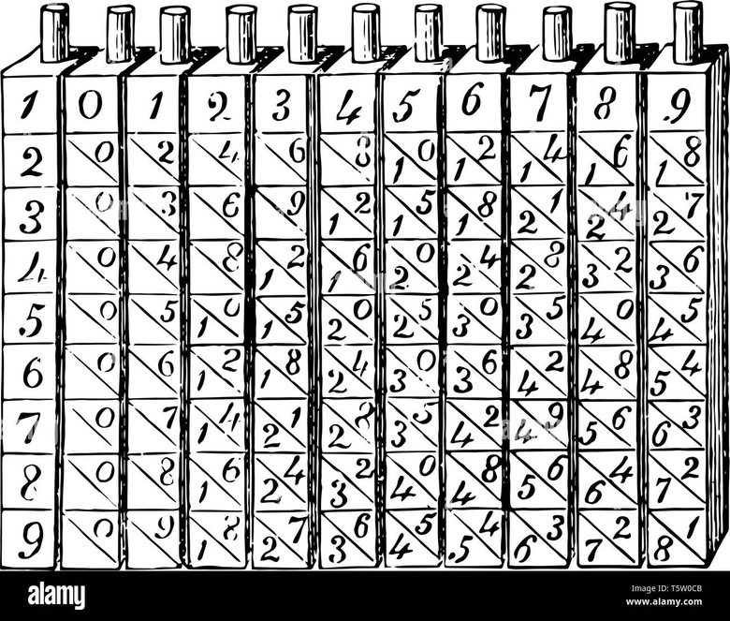
FUNDAMENTALS OF ICT
Napier’s Bones
  Invented by John Napier in 1614.
  Allowed the operator to multiply, divide and calculate square and cube roots by moving the rods around and placing them in specially constructed boards.
Notes:
PURPOSE:
main purpose of Napier’s Bones was to make multiplication and division easier and faster, especially for people who had to perform lengthy calculations.

Slide 10
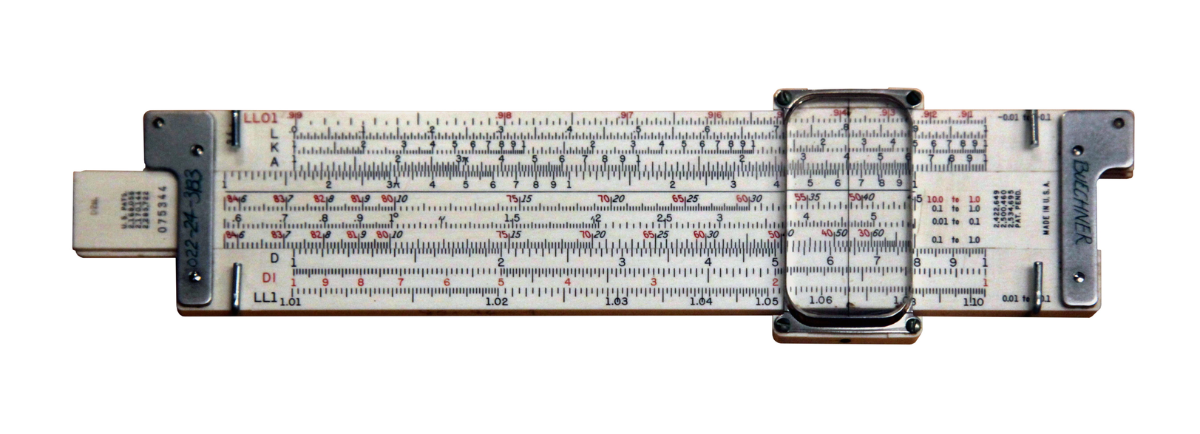
FUNDAMENTALS OF ICT
Slide Rule
  Invented by William Oughtred in 1622.
  Is based on Napier's ideas about logarithms.
  Used primarily for – multiplication – division – roots – logarithms – Trigonometry
  Not normally used for addition or subtraction.
Notes:
Napier's Bones and the Slide Rule have a similar main purpose
The similarity
Both were designed primarily to help humans perform mathematical calculations, especially:
Multiplication
Division
Napier's Bones used numbered rods containing multiples to make multiplication and division easier.
The Slide Rule used logarithmic scales to make multiplication and division faster by converting these operations into addition and subtraction of logarithmic values.

Slide 11
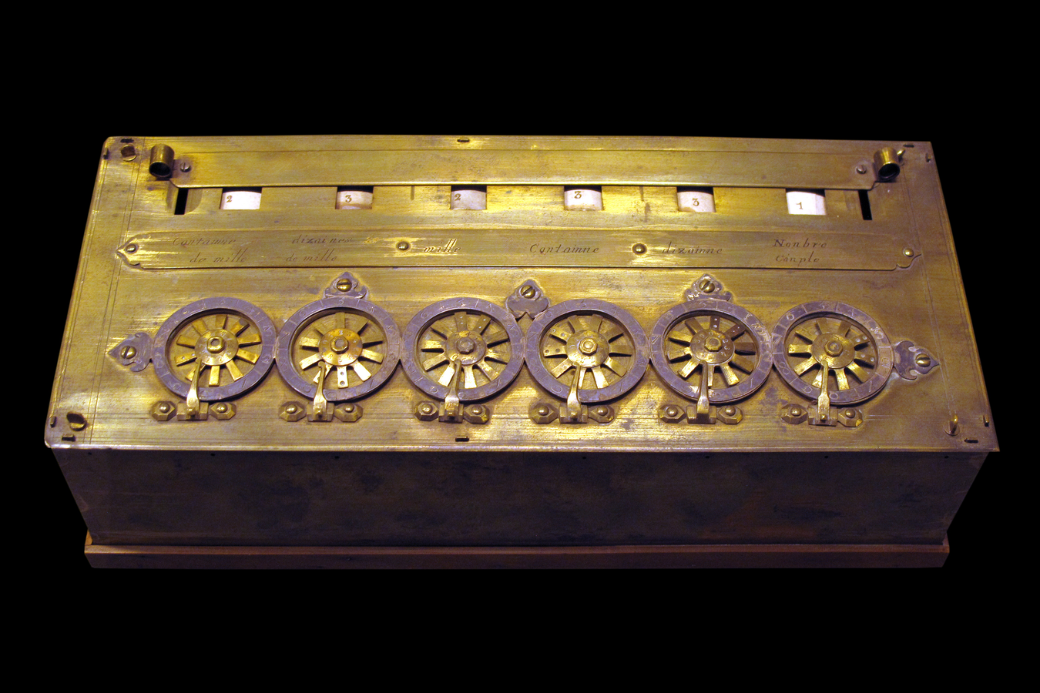
FUNDAMENTALS OF ICT
Pascaline
  Invented by Blaise Pascal in 1642.
  An early mechanical calculator designed to automatically perform addition and subtraction, reducing the effort required for repetitive arithmetic calculations.
  It was its limitation to addition and subtraction.
  It is too expensive.
Notes:
PURPOSE:
The main purpose of the Pascaline was to automate addition and subtraction using mechanical gears, making lengthy arithmetic calculations faster and reducing the effort and errors involved in manual calculation.
Primary Functions
Addition:
Numbers were entered by turning metal dials with a stylus, which directly advanced the gear-based numeric wheels.
Subtraction:
Performed indirectly using a complementary numbers system (9's complement) via a sliding display bar.
Multiplication and Division: Achieved indirectly through repeated addition or subtraction.

Slide 12
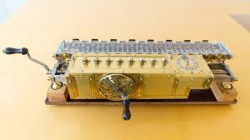
FUNDAMENTALS OF ICT
Stepped Reckoner
  Invented by Gottfried Wilhelm Leibniz in 1672.
  It was the first calculating machine capable of performing all four basic arithmetic operations: addition, subtraction, multiplication, and division
Notes:
PURPOSE:
The main purpose of the Stepped Reckoner was to mechanically perform the four basic arithmetic operations: addition, subtraction, multiplication, and division.

Slide 13
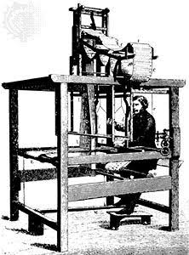
FUNDAMENTALS OF ICT
Jacquard Loom
  The Jacquard loom is a mechanical loom, invented by Joseph-Marie Jacquard in 1881.
  It is an automatic loom controlled by punched cards.
  This innovation allowed the fast, accurate production of complex textile patterns like brocade and damask and heavily influenced early computing.
Notes:
PURPOSE:
The main purpose of the Jacquard Loom was to automatically weave complex and detailed patterns into fabric using punched cards.

Slide 14
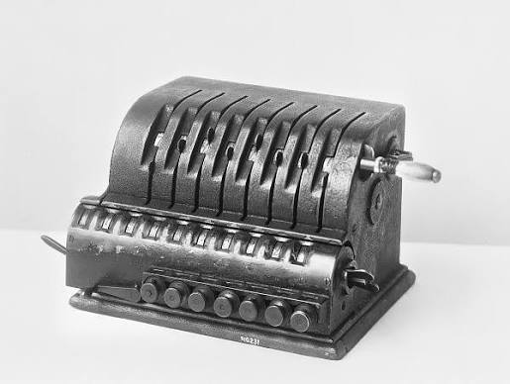
FUNDAMENTALS OF ICT
Arithmometer
  A mechanical calculator invented by Thomas de Colmar in 1820,
  The first reliable, useful and commercially successful calculating
  machine.
  The machine could perform the four basic mathematic functions.
  The first mass-produced calculating machine.
Notes:
The main purpose of the Arithmometer was to perform the four basic arithmetic operations mechanically: addition, subtraction, multiplication, and division.
The Stepped Reckoner and Arithmometer had a similar purpose, but the Arithmometer improved and commercialized the idea.

Slide 15
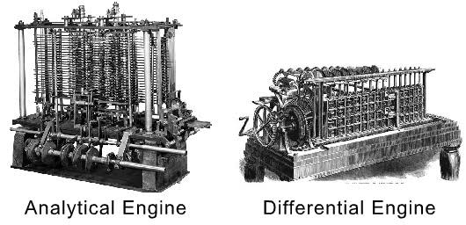
FUNDAMENTALS OF ICT
Difference Engine and Analytical Engine
  It an automatic, mechanical calculator designed to tabulate polynomial
  functions.
  Invented by Charles Babbage in 1822 and 1834
  It is the first mechanical computer.
Notes:
Main purpose:
To automatically calculate and print mathematical tables accurately.

Slide 16
FUNDAMENTALS OF ICT
Difference Engine and Analytical Engine
  Difference Engine
    Built strictly to crunch numbers and print mathematical and navigational tables using the method of finite differences.
  Analytical Engine
    Designed as the first Turing-complete, general-purpose automatic computing machine capable of executing any logical or mathematical task.
Notes:
DIFFERENCE:
Main purpose:
To automatically calculate and print mathematical tables accurately.
Simple explanation for students:
Difference Engine = an automatic calculator for producing mathematical tables.
ANALYTICAL:
Main purpose:
To create a general-purpose, programmable mechanical computing machine capable of performing different calculations according to instructions.
Simple explanation for students:
Analytical Engine = an early design for a programmable general-purpose computer.

Slide 17
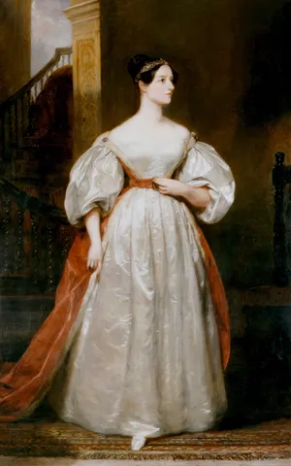
FUNDAMENTALS OF ICT
First Computer Programmer
  In 1840, Augusta Ada Byron (also known as Ada Lovelace) suggests to Babbage that he use the binary system.
  She writes programs for the Analytical Engine.
  Develop and publish a set of instructions (an algorithm) for Charles Babbage’s Analytical Engine.
Notes:
In very simple terms
Ada Lovelace's main contribution was to show how a machine could be given a sequence of instructions to perform a calculation.

Slide 18
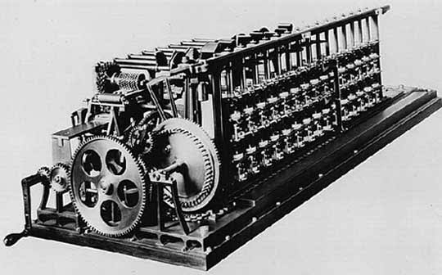
FUNDAMENTALS OF ICT
Scheutzian Calculation Engine
  Invented by Per Georg Scheutz in 1843.
  Based on Charles Babbage's difference engine.
  The first printing calculator.
  Designed to compute polynomial functions to automatically generate accurate logarithmic and trigonometric tables.
Notes:
Main purpose
Its main purpose was to automatically calculate and print mathematical tables, reducing the tedious work and human errors involved in calculating those tables by hand.
What made it important?
The Scheutzian Engine was particularly significant because it "turned Babbage's Difference Engine concept into a practical working machine." The 1853 version could calculate numerical differences and "print the results automatically." It was later sold to the Dudley Observatory in New York and became the first printing calculator sold.

Slide 19
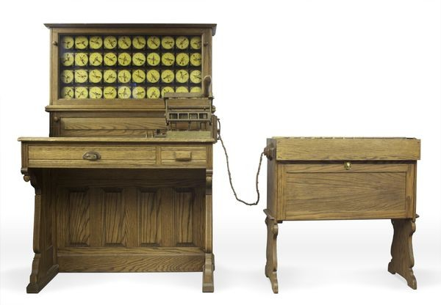
FUNDAMENTALS OF ICT
Tabulating Machine
  Invented by Herman Hollerith in 1890.
  Is an electromechanical device built to read, count, and summarize data stored on punched cards.
Notes:
The main purpose of the Tabulating Machine, specifically Herman Hollerith's Tabulating Machine, was to automatically process, count, and organize large amounts of data recorded on punched cards. It was developed primarily to make the U.S. Census much faster and more efficient.
Why was it important?
The previous census data had to be processed largely by hand. Hollerith's system dramatically accelerated the process. The U.S. Census Bureau reports that the machine allowed the 1890 census count to finish months ahead of schedule and far under budget.
The Tabulating Machine was designed to solve a data-processing problem. Instead of people manually counting thousands or millions of census records, Hollerith used punched cards and a machine to automatically read and count the information.

Slide 20
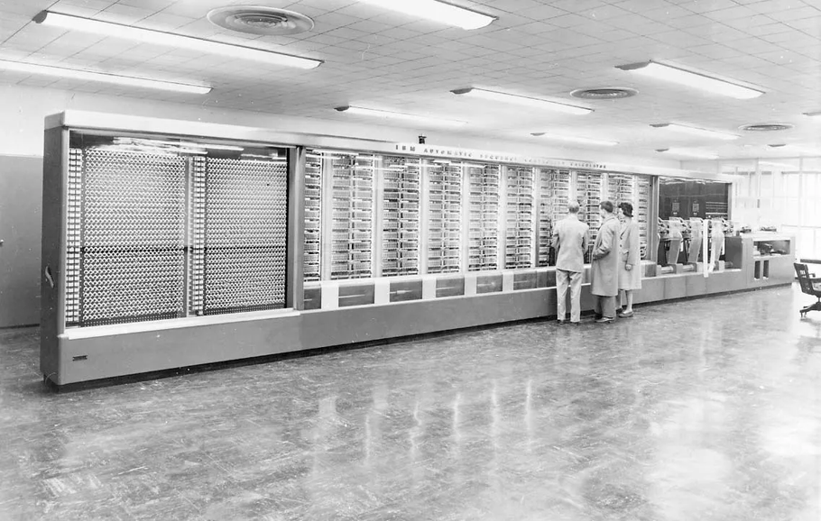
FUNDAMENTALS OF ICT
Harvard Mark 1
  Also known as IBM Automatic Sequence Controlled Calculator (ASCC).
  Invented by Howard H. Aiken in 1943
  The first electro-mechanical computer
Notes:
The Harvard Mark I was mainly designed to automatically perform long and complex mathematical calculations, particularly calculations needed for scientific and military applications during World War II. It was designed by Harvard mathematician Howard H. Aiken and built with IBM; it became operational at Harvard in 1944.
What was it used for?
The Mark I was heavily used for military calculations, including:
Torpedo design
Radar calculations
Missile trajectories
Underwater detection systems
Other mathematical problems related to the war effort
It also calculated mathematical functions such as Bessel functions, which earned it the nickname "Bessie."

Slide 21
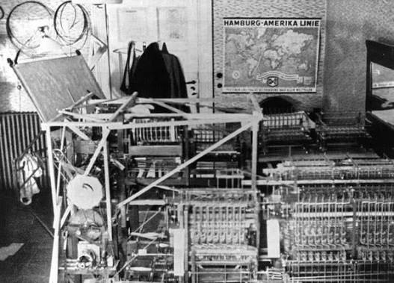
FUNDAMENTALS OF ICT
Z1
  The first programmable computer.
  Created by Konrad Zuse in Germany from 1936 to 1938.
  To program the Z1 required that the user insert punch tape into a punch tape reader and all output was also generated through punch tape.
Notes:
The main purpose of the Z1 was to automate mathematical calculations using a programmable, binary mechanical computer. It was developed by Konrad Zuse and completed in 1938.
In very simple terms
Z1 = a programmable machine designed to perform mathematical calculations automatically.
What could the Z1 do?
The Z1 could perform the basic arithmetic operations using binary floating-point numbers, including:
Addition
Subtraction
Multiplication
Division

Slide 22
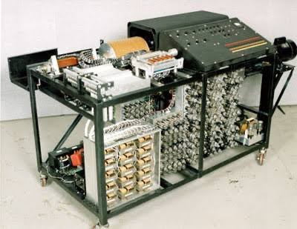
FUNDAMENTALS OF ICT
Atanasoff-Berry Computer (ABC)
  It was the first electronic digital computing device.
  Invented by Professor John Atanasoff and graduate student Clifford Berry at Iowa State University between 1939 and 1942.
Notes:
The main purpose of the Atanasoff–Berry Computer (ABC) was to automatically solve large systems of simultaneous linear equations, particularly for scientific and engineering calculations. It was designed by physicist John Vincent Atanasoff with graduate student Clifford Berry at Iowa State College between 1939 and 1942
In very simple terms
ABC = an electronic machine designed to solve difficult mathematical equations faster and more accurately than humans could calculate them by hand.
How I would explain it to your students
You can say:
"The ABC was built for a specific problem: solving large systems of linear equations. Its importance in computer history comes from how it solved that problem—using electronic digital circuits and binary arithmetic instead of primarily mechanical components."
"ABC was a special-purpose electronic digital computer designed specifically to solve systems of linear equations."

Slide 23
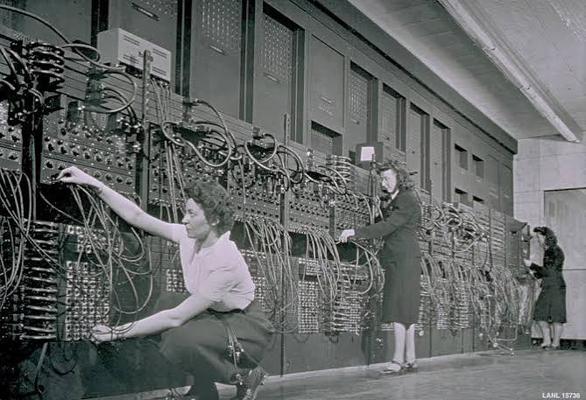
FUNDAMENTALS OF ICT
ENIAC
  ENIAC stands for Electronic Numerical Integrator and Computer.
  It was the first electronic general-purpose computer.
  Completed in 1946.
  Developed by John Presper Eckert and John Mauchly.
Notes:
The main purpose of ENIAC (Electronic Numerical Integrator and Computer) was to perform complex mathematical calculations electronically and very quickly, especially to calculate artillery firing/ballistics tables for the U.S. Army during World War II.
A good explanation for your students
I would say:
"The ENIAC was built to solve a practical wartime problem: calculating artillery firing tables. But its importance went beyond that purpose. It demonstrated that electronic circuits could be used to perform complex calculations at extremely high speeds."

Slide 24
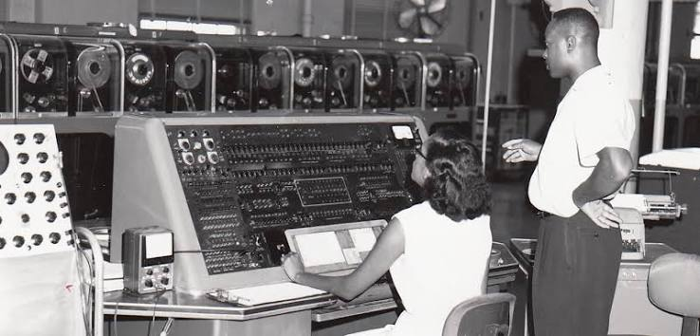
FUNDAMENTALS OF ICT
UNIVAC 1
  The UNIVAC I (UNIVersal Automatic Computer 1) was the first commercial computer.
  Designed by John Presper Eckert and John Mauchly.
Notes:
The main purpose of UNIVAC I (Universal Automatic Computer I) was to automatically process large amounts of data and perform calculations much faster than mechanical tabulating machines. It was designed as a general-purpose electronic data-processing computer, rather than a machine limited to one particular calculation
The important distinction for your students
UNIVAC I is especially important because it represents a shift from:
"Computers are mainly used for scientific calculations."
to:
"Computers can process information for government and business."
It was used for census and economic data, and early business applications included things such as inventory management and payroll calculations.

Slide 25
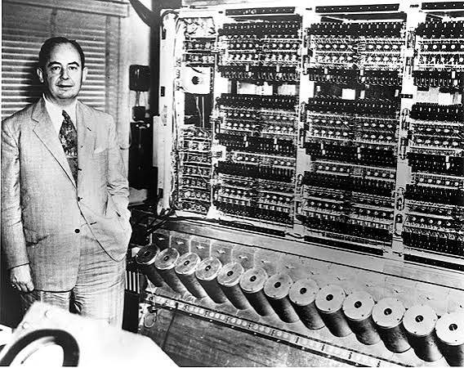
FUNDAMENTALS OF ICT
EDVAC
  EDVAC stands for Electronic Discrete Variable Automatic Computer
  The First Stored Program Computer
  Designed by Von Neumann in 1952.
  It has a memory to hold both a stored program as well as data.
Notes:
The main purpose of EDVAC (Electronic Discrete Variable Automatic Computer) was to perform electronic digital calculations using a stored program—meaning the computer could store both instructions and data in its memory and execute the instructions automatically.
In very simple terms
EDVAC = an early electronic computer designed to store its program in memory, allowing it to be reprogrammed more easily.
EDVAC vs. ENIAC
Think of it this way:
ENIAC
"I can calculate very fast, but if you want me to do a different task, you need to change my wiring and switches."
Changing ENIAC's configuration could require substantial human effort.
EDVAC
"Give me the program and data, and I can store them in my memory and execute the instructions."
This stored-program concept made computers much more flexible and became a foundation of modern computer design.
How I would explain it to your students
You can say:
"ENIAC was like a calculator that had to be physically configured for different tasks. EDVAC introduced a better idea: instead of physically rewiring the machine, we could store the instructions in memory. The computer could then read and execute those instructions."

Slide 26
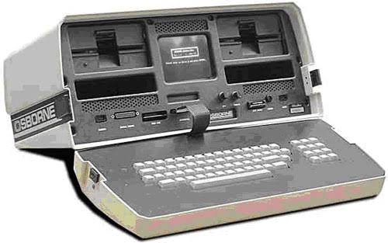
FUNDAMENTALS OF ICT
The First Portable Computer
  Osborne 1 – the first portable computer.
  Released in 1981 by the Osborne Computer Corporation.
Notes:
The main purpose of the Osborne 1 was to provide a portable personal computer that people could carry and use for work outside a traditional office or home computer setup.
The Osborne 1 was introduced in 1981 and is widely regarded as the first commercially successful portable computer. It was designed to be transported between places, such as the office and home.
So you could explain:
"The Osborne 1 was not created to perform one specific calculation like the Difference Engine or ABC. It was a general-purpose personal computer designed to allow users to perform everyday computing tasks while being able to transport the computer."

Slide 27

FUNDAMENTALS OF ICT
The First Computer Company
  The first computer company was the Electronic Controls Company.
  Founded in 1949 by John Presper Eckert and John Mauchly.
Notes:
Main purpose
The company's main purpose was to design, develop, manufacture, and sell electronic computers commercially.
In simple terms:
The First Computer Company was established to turn electronic computing from a research project into commercially available computer systems.
What did the company actually develop?
One of its major projects was BINAC (Binary Automatic Computer), built for Northrop Aircraft. The company then developed UNIVAC, which became the first commercial computer in the United States.

Slide 28
THANK YOU

